Slide 1
Section 3 Requirements for Affordable and Special Needs Housing (ASNH) Developers
Virginia
Department of Housing and Community Development (DHCD)
February 2016

Slide 2
What is Section 3?
Section 3
The Housing & Urban Development Act of 1968 requires recipients to direct employment, job training and contracting economic opportunities, to the greatest extent feasible, to low- and very low-income persons in neighborhoods where HUD funds are invested.
Notes:
The intent is to boost the opportunities for competing for local, LMI businesses and persons

Slide 3
When does Section 3 apply?
Section 3
Only to projects of a certain size and scope = All ASNH projects
All project related contracts and subcontracts (Construction or Non-Construction) $100,000 or more
Applies to all project related new hires or contracting opportunities

Slide 4
Minimum Goals
Section 3
30 - 10 - 3
30% of new hires annually
10% of total dollar amount of covered construction contracts (annual)
3% of the total dollar amount of covered non-construction contracts (annual)

Slide 5
Section 3 Resident
Low (80% or below AMI) and very-low (50% or below AMI) individuals living in the project area
Not required to hire someone not qualified to perform job
Resident of public housing
Certification documentation required

Slide 6
Residents
Section 3
Public Housing Resident - automatic
Persons of a metro or non-metro county who qualify as LMI
They must complete a certification form

Slide 7
Section 3 Business
51% or more owned by Section 3 residents
Has 30% or more of full-time employees who are currently Section 3 residents (or at least were within three years of hire date)
Subcontracts at least 25% of all subcontracts to Section 3 businesses
Certification documentation required

Slide 8
Intended Beneficiaries
Section 3
Based on income and location
Race and/or gender do not apply

Slide 9
Compliance
Must document efforts
Must report annual data to DHCD
If goals are not achieved grantee must document efforts and barriers

Slide 10
Strategies
Section 3
Build a business registry/mailing lists
Send invites to local businesses to complete certification documents
Send invites to local affordable housing agencies for distribution to their clients to become Section 3 Residents
Conduct a job fair in project area

Slide 11
Your Responsibility
Section 3
Commit to Section 3 goals
Implement Section 3 strategy
Identify local businesses needed
Mail invites for application for certification
Publish advertisement (local/display)
Target solicitations for job openings
Add respondents to bid documents
Document new hires on payrolls including Section 3 Resident certifications

Slide 12
Document Document Document
Section 3
If no Section 3 residents and/or firms are identified or bid, you must document efforts and any impediments.
Include the following in your recruitment efforts: distribution of flyers in LMI neighborhoods, posted signs for job availability, contacted resident organizations, local CDC’s and VEC’s, be creative.

Slide 13
Required Forms
Business and Employment Plan (required for each project)
Business and Employment Notice (required for all projects)
Contract/Subcontractor Plan (required for all contracts over $100,000)
Business Certification Form (required for all businesses claim to be Section 3)
New Employee Tracking Form (required for all new hires on the project)
Resident Qualification Form (required for all new Section 3 hires)

Slide 14
Resources
Section 3 Policies and Procedures –all required forms can be found here
DHCD Contact:
Nancy Palmer
nancy.palmer@dhcd.virginia.gov

Slide 15
Reporting Requirement
New HUD process for reporting
DHCD must report aggregate project data annually to HUD
Reporting period based on federal fiscal year (October 1 – September 30)
Projects will report annually beginning with 2014 – 2015 reporting period (CAMS-based report)

Slide 16
Report Due Dates
Submitted to DHCD through CAMS
October 1, 2014 – September 30, 2015
Due to DHCD by March 31, 2016
October 1, 2015 – September 30, 2016
Due to DHCD by October 10, 2016

Slide 17
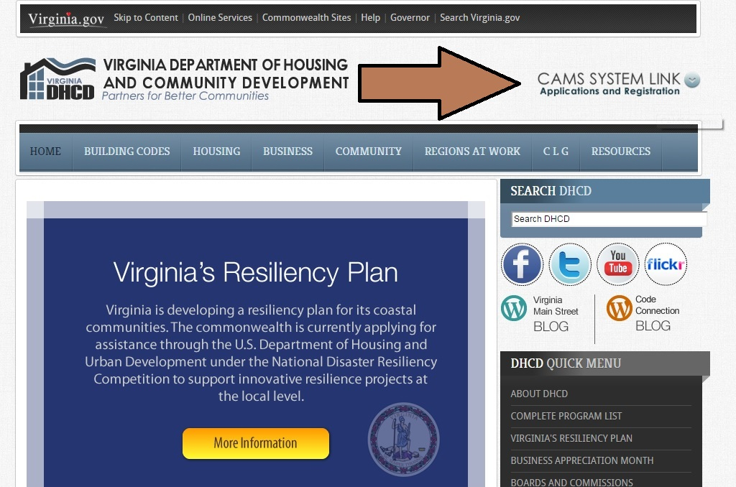
Insert Screen Shots After this…
Where to find CAMS
Location of Section 3 Report (Due March 31, 2016)
Section 3 Report Content

Slide 18
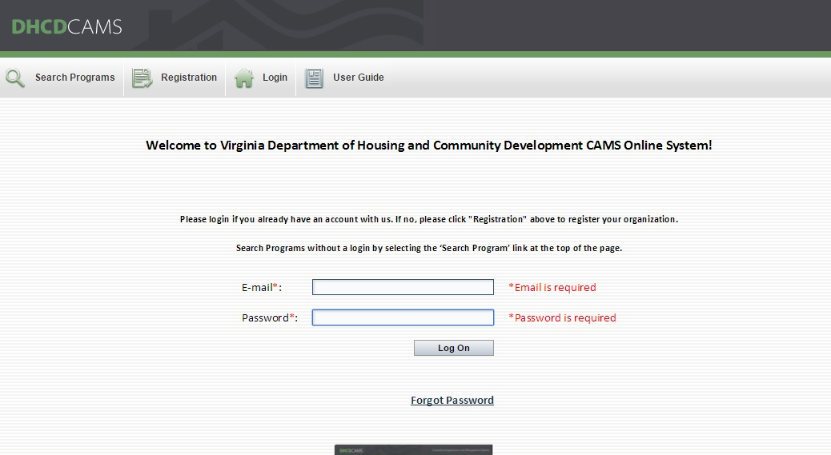

Slide 19
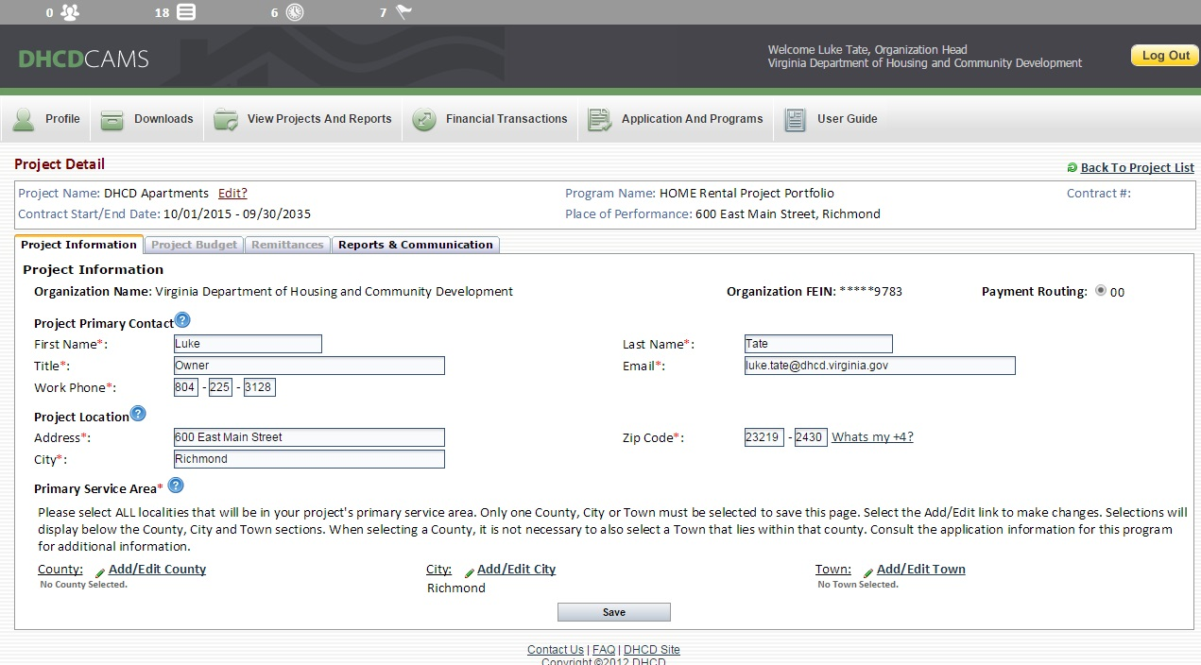

Slide 20
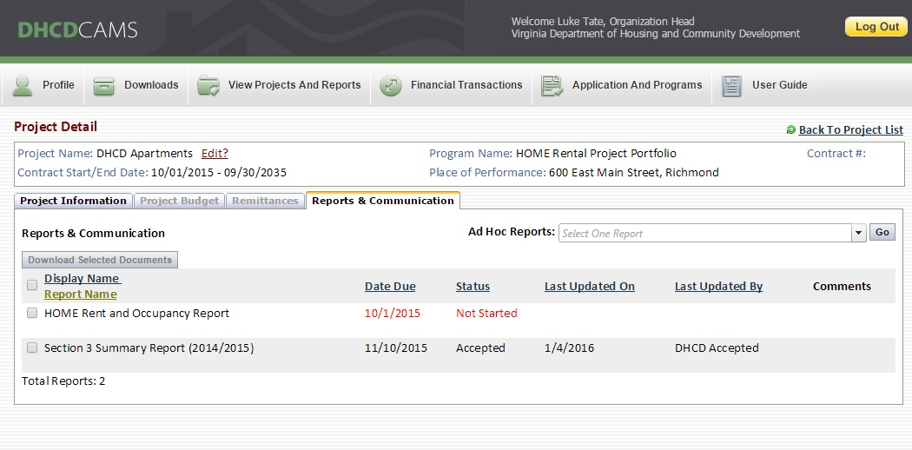

Slide 21
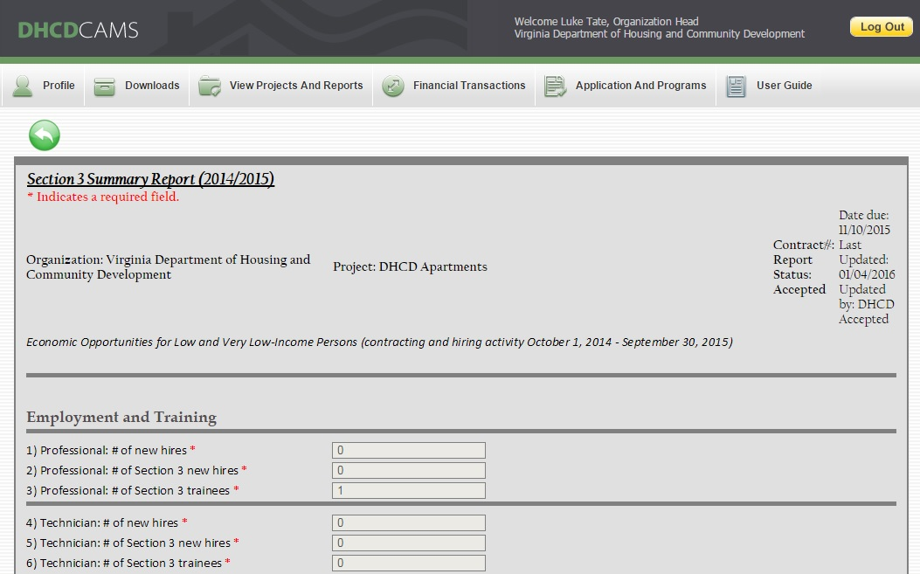

Slide 22
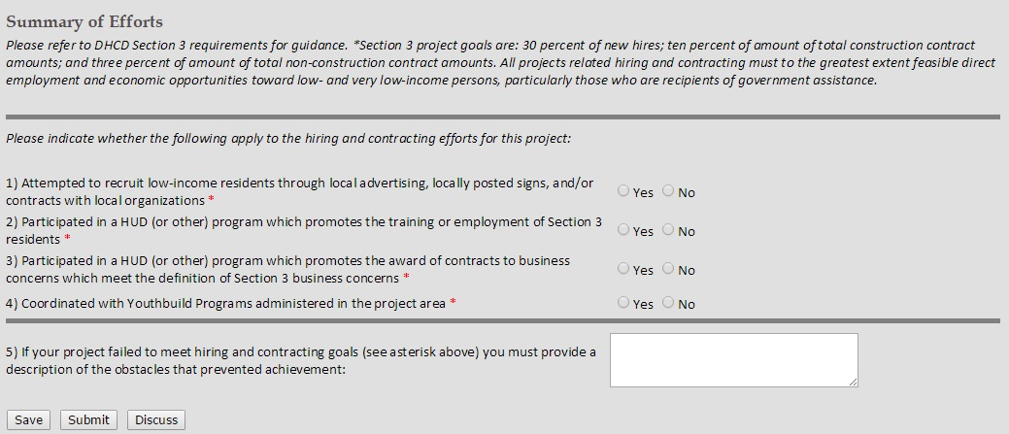

Slide 23
QUESTIONS?
DHCD Staff Presenters:
Willie Fobbs, Associate Director of Housing Production
Lyndsi Austin, Associate Director of Housing Policy

