Slide 1
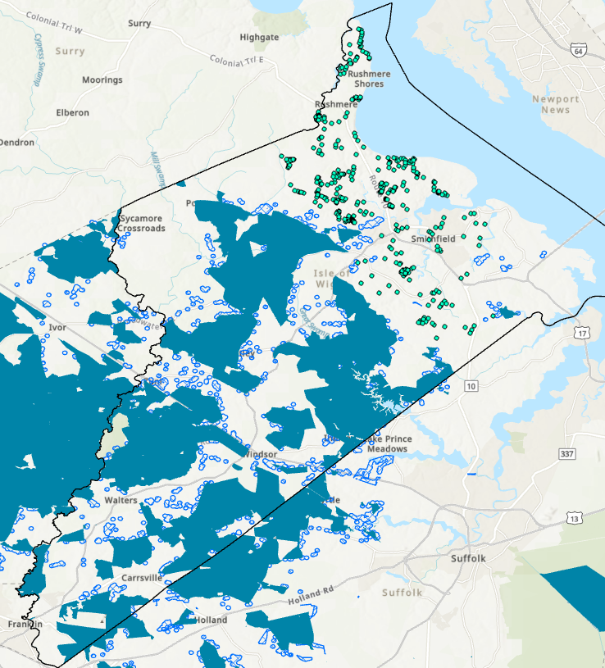
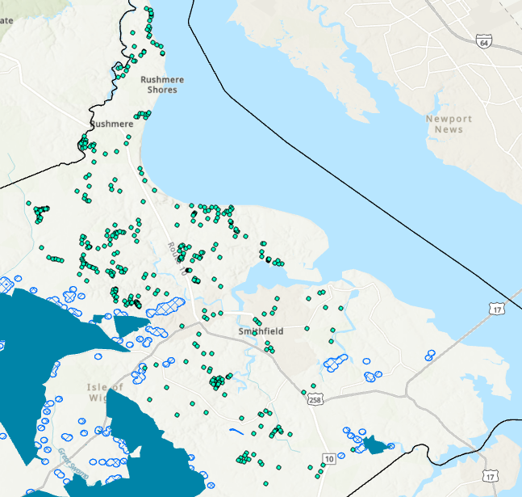
VA Isle of Wight County
Close-up View
- County Border
- Charter RDOF
- Charter Grant Awards
- VA BEAD Eligible Locations

