Slide 1
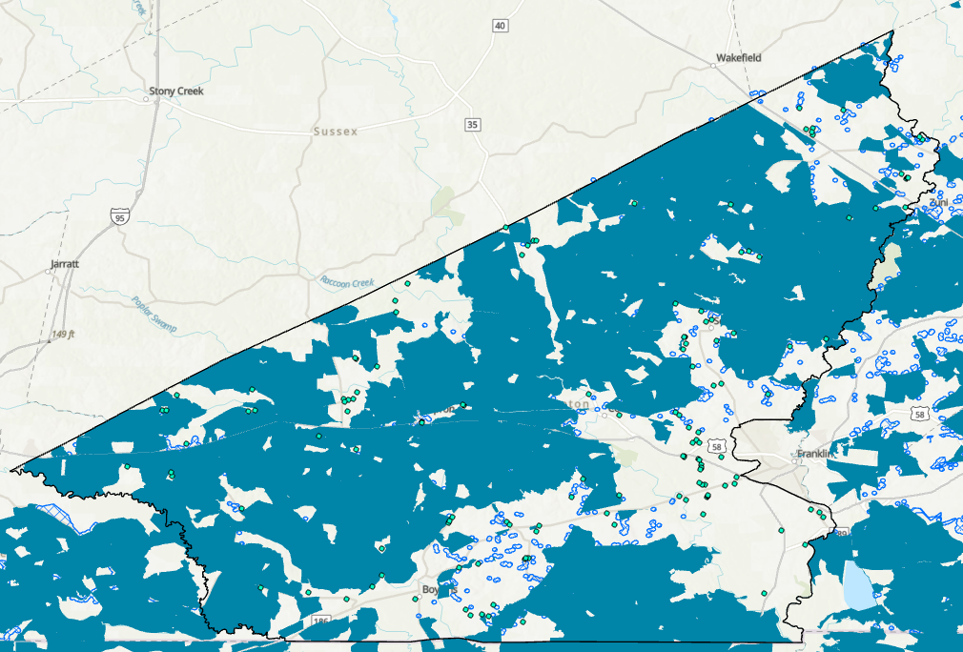
VA Southampton County
- County Border
- Charter RDOF
- Charter Grant Awards
- VA BEAD Eligible Locations
Close-up View

